Slide 1
Customer Interaction Center - CIC
Technical Support and RMA Tutorial

Slide 2
You will need a username and password to obtain access to the CIC
If you do not have a username and password. Please go to http://www.radisys.com/Support/Telecom-and-Commercial.html and click on Request Login.
You may also send an email to support@radisys.com
Once you have your username and password you will go to http://www.radisys.com/Support.html and choose the type of Customer you are and select the “Get Support” button.
For Technical Support you will login to the Premier Support Portal.

Slide 3
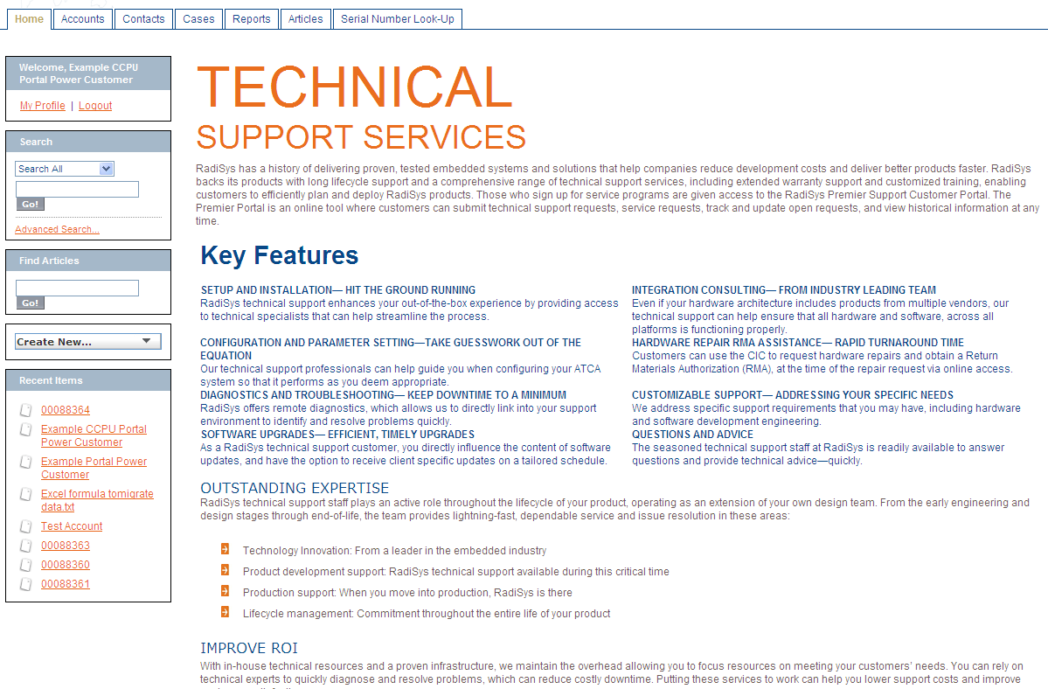
Technical Support Home Page
From the home page you can:
view your profile, logout, search, find articles, see recent items and create a new case

Slide 4
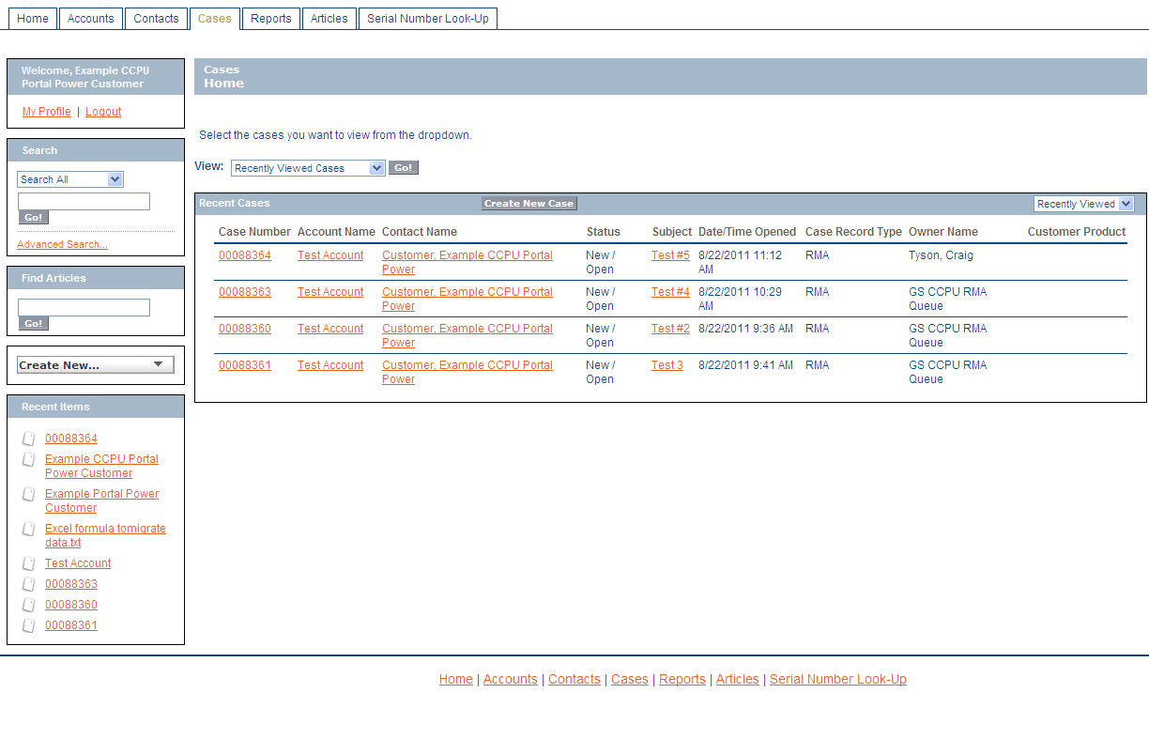
Viewing or Checking Status on Open and/or Closed Cases
Use the view dropdown and pick from one of the following:
My Cases- My Closed Cases- My Company’s Cases- My Company’s Closed Cases
My Company’s Open Cases- My Open Cases and Recently viewed cases

Slide 5
Creating a new Technical Support / Defect Request

Slide 6
To Report a Technical Support Issue
From Cases Page – click on the Create New Case button
Choose the Select Case Record Type- “Defect”
Click on the Continue button
Fill in the Name of your Product – if your product name does not come up choose the first letter of your product and place an asterisk* next to it.
Place a short description of the issue in the Subject Field
Enter the Description of the issue that you are having in the description field. Reproduction steps, Type of Issue .. Ect.
Choose a Severity – Low, Minor, Major or Critical
Click on the Submit button
Please note to attach a file you will need to click the Submit button first.

Slide 7
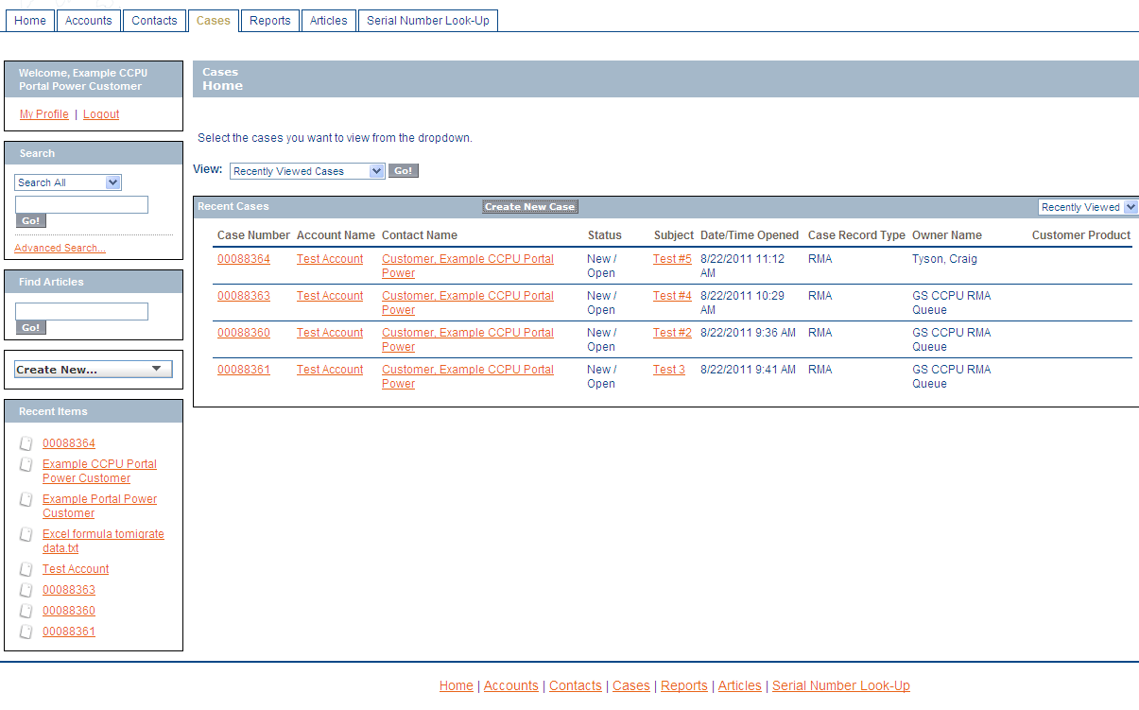
Adding an Attachment / Comment or to Edit
When your case has been submitted go back to the Case page. You will have different options in the View field for submitted Cases.
My Cases, My Closed Cases, My Company’s Cases, My Company’s Closed Cases, My Company’s Open Cases, My Open Cases, Recently Viewed Cases.
Once you have picked your view you may double click the “Case Number” and choose to:
Attach a File, Add a Comment or Edit your Case.

Slide 8
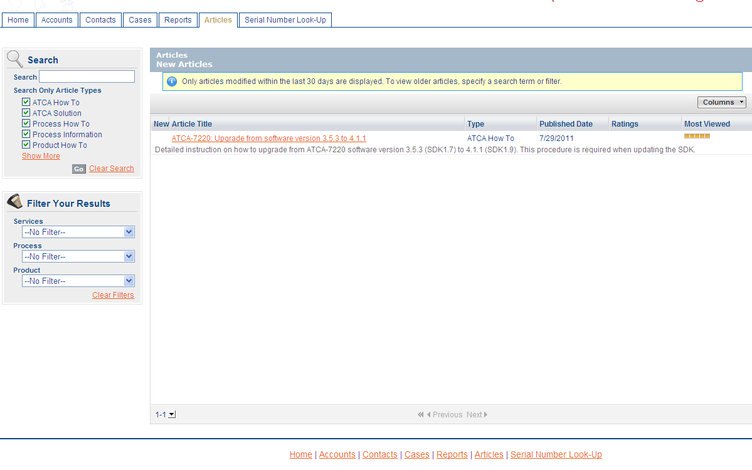
Articles Page
You can search for Articles that are in the RadiSys CIC Data Base:
How to Articles and Services Information –
Please note that articles are limited at this time due to this
Page is still being developed.

Slide 9
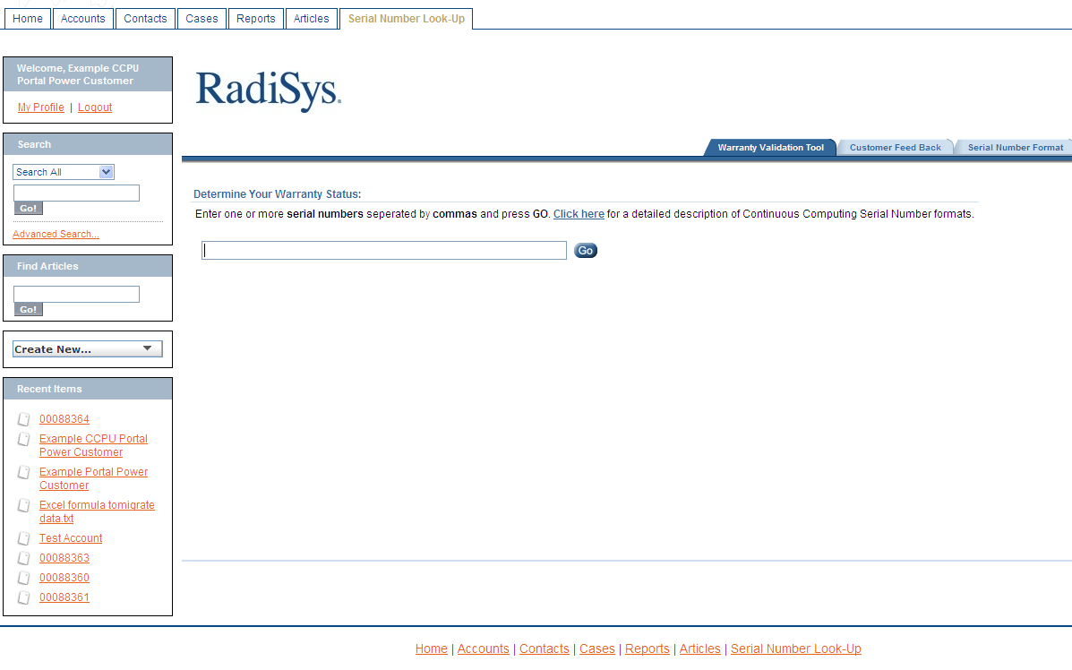
Serial Number Look Up
Within this Page are 3 Tabs
Warranty Validation Tool Tab - check warranty validation
Customer Feed Back Tab – use to give additional comments
Serial Number Format Tab –show different serial number formats

Slide 10
Creating a new RMA Request

Slide 11
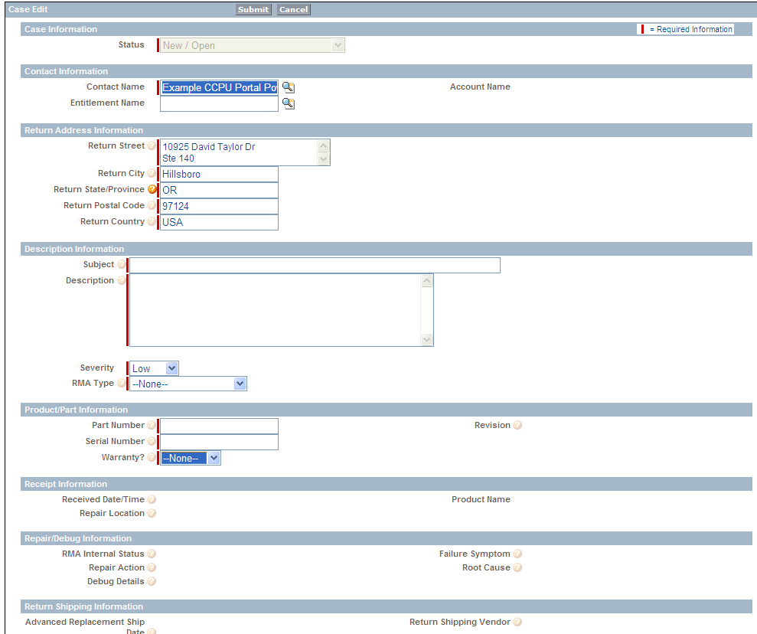
How to Submit an RMA
From Cases Page – click on the Create New Case button
Choose the Select Case Record Type- “RMA”
Click on the Continue button
Fill in all the mandatory fields that are marked with a RED line to the left of the field box as shown below.

Slide 12
Choices from Drop Down Menu’s
Severity, RMA Type and Warranty are all selections with the drop down menu.
Severity - Choose from: LOW, MINOR, MAJOR AND CRITICAL
RMA Type – Choose from: ADVANCE REPLACEMENT, EVAL RETURN, REPAIR ONLY, REPAIR AND UPGRADE, RETURNED UNREPAIRED, UPGRADE ONLY
Warranty - Choose from: EXTENDED, NO, YES, UNKNOWN
Once all the fields are completed Click on the Submit button
You will be able to find your RMA in the Cases home tab [any view] you will see that the Case Record Type will show RMA.

Slide 13
Questions or Concerns
If you have any questions or concerns…
I can be available at your convenience for conference calls
and / or Web EX.
Please contact me-
Susie Achenbach
susie.achenbach@radisys.com
Office: 503-615-1733 | Cell: 503-720-5094

